Slide 1
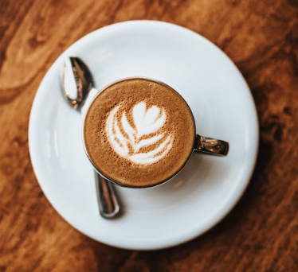
Project No. 606 - Bar Ilan University Software Development Café recommendation system for coffee enthusiastic
Elevating Coffee Discovery to a New Level of Quality
Omer Sela & Ahigad Genish
Project Supervisors:
Professor Gelles Ran
Professor Cohen Izack

Slide 2
Introduction
Problem Statement:
Existing recommendation systems focus on popularity, not quality.
Coffee lovers deserve better—quality over convenience.
Current platforms fail to address the specific needs of coffee enthusiasts.

Slide 3
Introduction
Solution:
We built a website that lets users choose: their coffee shop desired location, the type of coffee they would like to drink, and whether they dine-in or take-away.
The system uses Google Maps API services to find coffee shops close to the selected location, filters coffee shops in which it identifies the type of coffee requested, and rates the quality of the coffee according to various criteria.

Slide 4
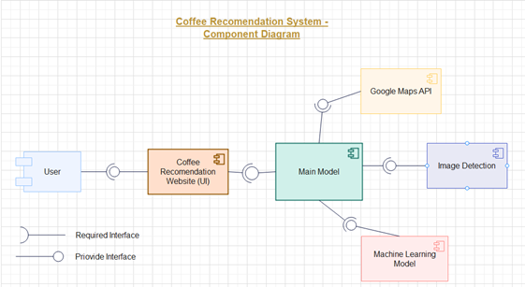
Our System
Key Features:
Personalized recommendations based on crema presence, serving style, and cup type.
Real-time data integration with Google Maps.
Machine learning-driven image analysis for precise coffee quality assessment.

Slide 5
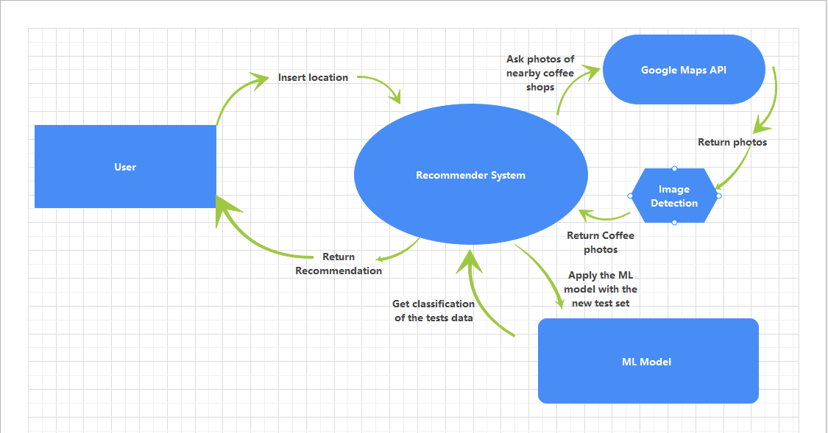
Our System
How It Works:
Step 1: User selects location and preferences.
Step 2: System retrieves coffee shop data from Google Maps.
Step 3: Advanced image detection and classification evaluate coffee quality.
Step 4: Personalized recommendations are delivered instantly.

Slide 6
WEBSITE LINK…

Slide 7
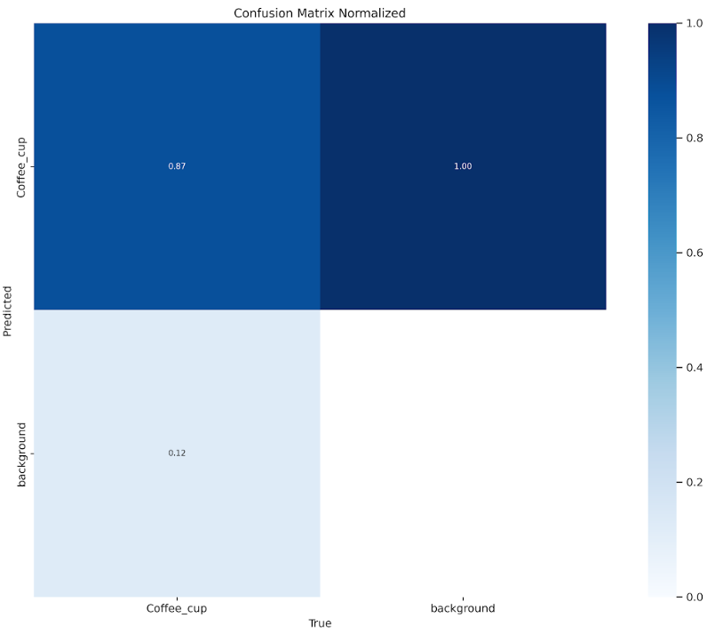
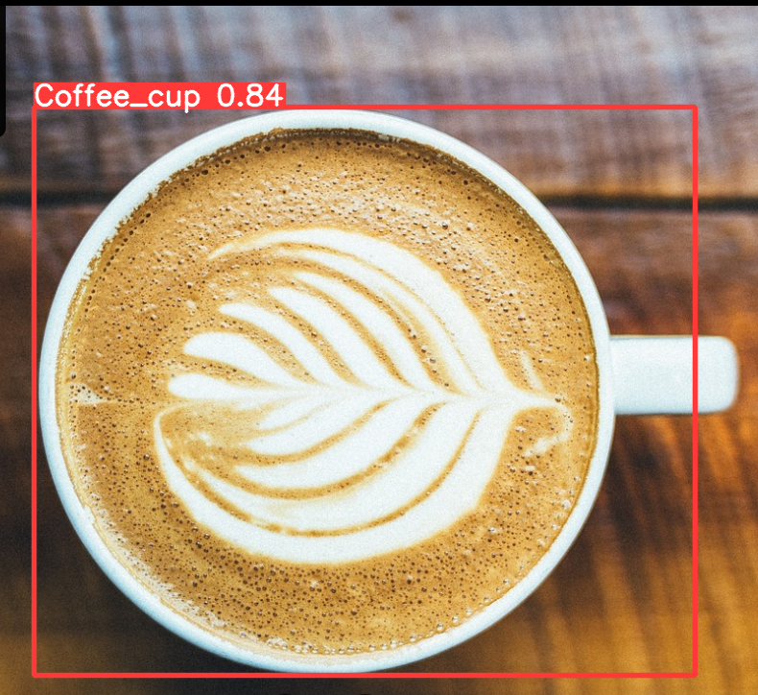
Technology
Image Detection:
Utilizes YOLOv8 for fast and accurate coffee cup detection.
We utilized the Open Images dataset to source coffee cup photos.
Accuracy of 87% and speed of approximately 190 millisecond per image.

Slide 8
Technology
Machine Learning Models:
Segmented models for coffee type, crema, cup type, and serving style.
To prepare our dataset for training model, we manually labeled 700 images with specific features that characterize the quality and presentation of the coffee.
Using augmentation techniques we expanded the dataset to approximately 10,257 images.
Utilizes YOLOv8 for fast and accurate attributes classification.
Allow to evaluate the coffee quality based on this attributes.
Ensures high accuracy in evaluating coffee quality.

Slide 9
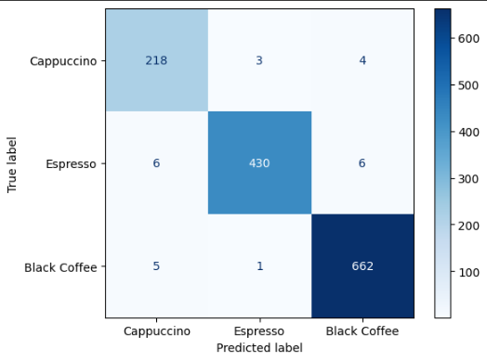
Technology
Coffee Type Machine Learning Model:
This model predicts the type of coffee in each cup.
It classifies the coffee as Black Coffee, Cappuccino, Espresso, or None of the Above.
In a test conducted on 1,335 coffee images, the accuracy was about 98%.

Slide 10
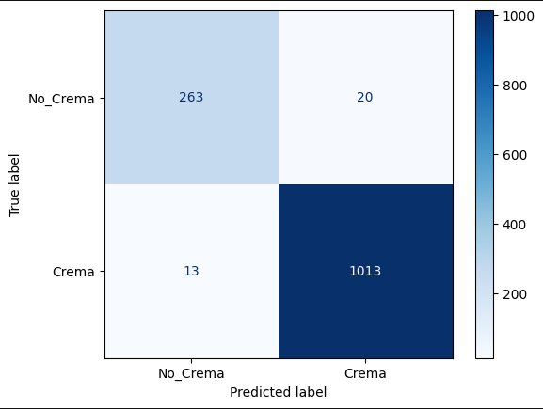
Technology
Crema Machine Learning Model:
This model predicts whether the given coffee cup contains crema, an indicator of coffee quality and freshness.
In a test conducted on 1,335 coffee images, the accuracy was about 95%.

Slide 11
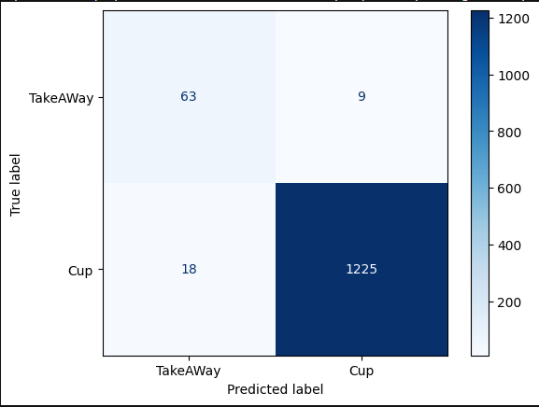
Technology
Cup Type Machine Learning Model:
This model identifies whether the coffee cup is intended for takeaway (disposable) or if it is served in a ceramic or glass cup, which can impact the drinking experience.
In a test conducted on 1,335 coffee images, the accuracy was about 96%.

Slide 12
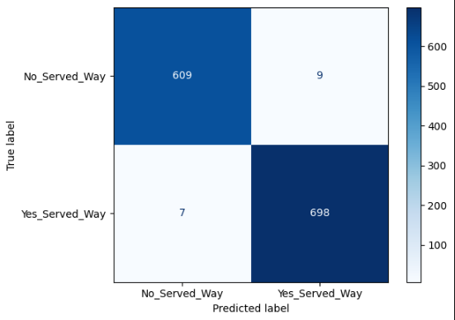
Technology
Serving Style Machine Learning Model:
This model predicts whether the coffee cup is served with a saucer or spoon, elements that enhance the customer’s experience.
In a test conducted on 1,335 coffee images, the accuracy was about 97%.

Slide 13
Technology
Google Maps:
Leverage the Google Maps API to retrieve coffee shop locations and images, enabling a comprehensive evaluation of coffee quality.
React & Flask:
Deploy the system as a website using React for the frontend and Flask with Python for the backend server

Slide 14
User Experience
Seamless Interaction:
Responsive design built with Flask and React.js.
Real-time filtering and instant feedback enhance user experience.
Visual Appeal:
Integrated with Chakra UI for a modern, aesthetic interface.
Optimized for mobile, tablet, and desktop use.

Slide 15
Results & Performance
Efficiency:
Rapid processing and delivery of recommendations.
High accuracy in coffee quality assessment.
User Satisfaction:
Tailored recommendations lead to a better coffee experience.

Slide 16
Future Potential
Scalability:
System designed to accommodate expansion to more cities and additional coffee features.
Enhancements:
Future models could include more nuanced coffee characteristics.
Potential integration with other data sources for even richer recommendations.

Slide 17
Thank you!
Q&A:
We’d love to hear your thoughts and questions!
Contact Information:
Ahigad Genish: ahigad.genish@gmail.com
Omer Sela: omersela1010@gmail.com

